Slide 1
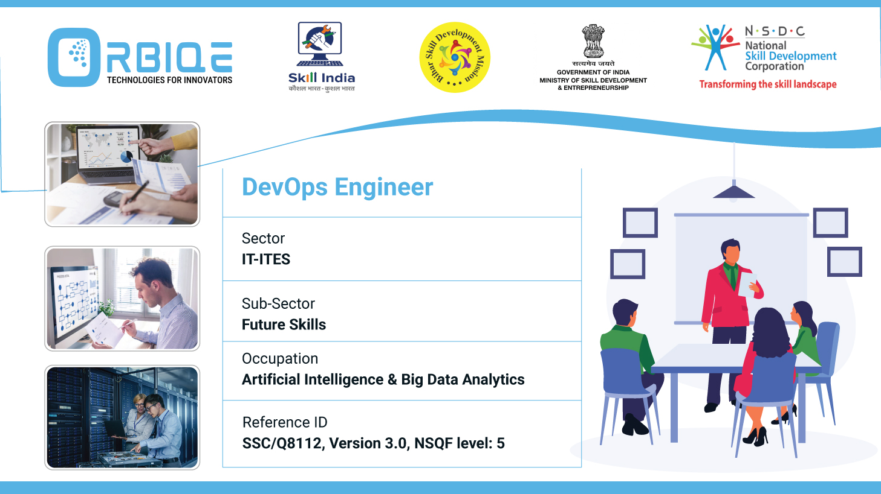
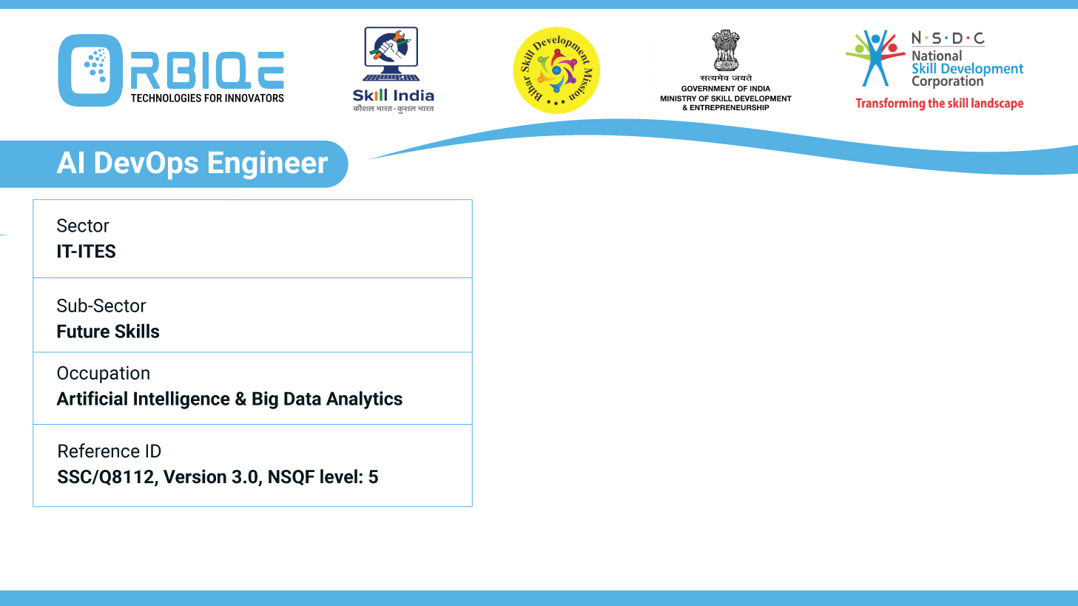
Name- Krishna Kant Dubey

Slide 2

Test Automation with Tools

Slide 3
Agenda
Utilize Selenium for automating web application testing
Create automated test
Execute automated test

Slide 4
Utilize Selenium for automating web application testing

Slide 5
Create automated test

Slide 6
Execute automated test

Slide 7
Thank You

